Slide 1
Capstone Project
www.collaberadigital.com

Slide 2
Personal BACKGROUND
(Name, Past Experience, Qualification, Career Summary)
Name : Andrei-Alexandru Mocanu
Past Experience:
INSOFTDEV – Private Taxi Booking Platform – Angular/AngularJS.
BearingPoint – Dynamic Form Generator – Web application with Angular, NestJs, Postgres, unit testing with Jest, Docker and Azure.
Qualification:
- Bachelor’s degree in Informatics (2021)
Career Summary:
Sept 2019 - Aug 2020 -> WordPress Developer (Freelancing)
Aug 2020 – Apr 2022 -> FrontEnd Developer (Angular/AngularJS)
Apr 2022 – Mar 2023 -> Fullstack Developer (Angular/Node.js)

Slide 3
Key Takeaways/Learnings from the Program (HTD)
JavaScript is a versatile programming language that is widely used in web development projects, while TypeScript is a superset of JavaScript that provides additional features and stricter type-checking.
In this training, I have learned how to integrate front-end and back-end technologies using Angular and .NET, building modern, scalable, and high-performing web applications.
TypeScript provides additional benefits over JavaScript, including static type-checking, better code organization, and improved tooling, which can help developers write more maintainable and error-free code.
Angular provides a robust structure for building web applications, with features such as dependency injection, reactive programming, and observables, which make it easier to manage complex data flows and ensure that the application remains responsive and scalable.
NET provides a powerful back-end framework for building web APIs, handling data persistence with Entity Framework Core, and managing security and authentication.

Slide 4
Problem Statement of the Capstone Project
The training management System is an online application developed using angular and WebAPI, where HR Manages and maintains Employee trainings to upgrade their skills
TMS will have following users:
HR
Manager
Employee
HR:
Will Maintain Employee and manager data
HR can perform CRUD operations
Will Schedule upcoming Trainings for employees
Manager:
Can View employee details along with Training details applied by employee
Can Approve or Reject training applied by employee
Can View Feedback given by employee

Slide 5
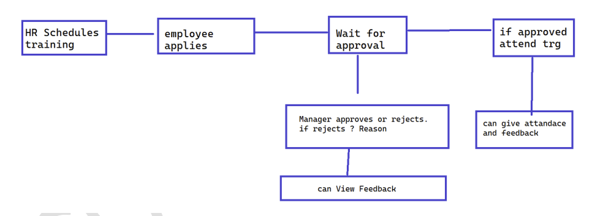
Employee:
Logins and apply for required skills scheduled by HR
Can apply for multiply trainings
Can give attendance during training
Can View training history
Can cancel training applied
Can Give Feedback on training
Can change profile like (mobile no, Address)
Can Check the status weather training is approved by manager or not
You need to create following Test cases:
Check if new user is created not
Return appropriate message for existing user
Validate user credentials

Slide 6
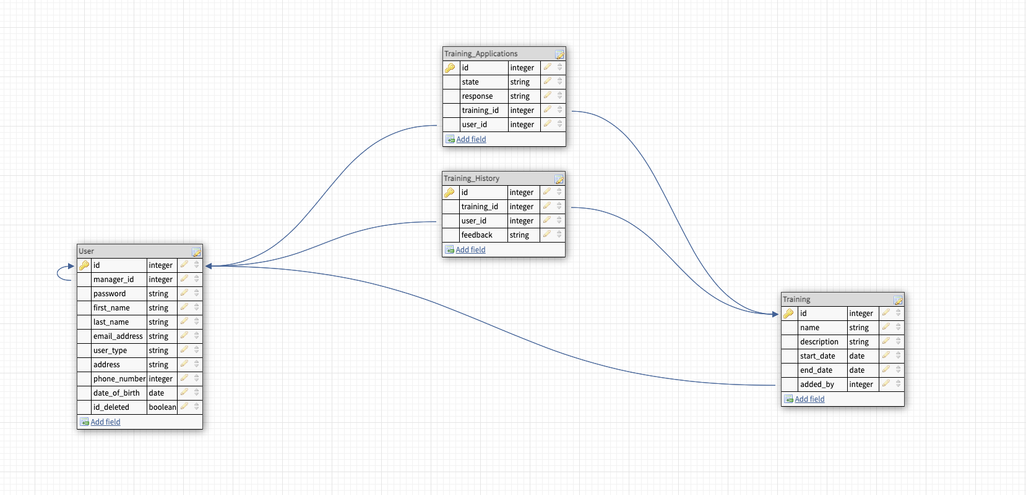
Important areas of the Project with screenshots
Database schema

Slide 7
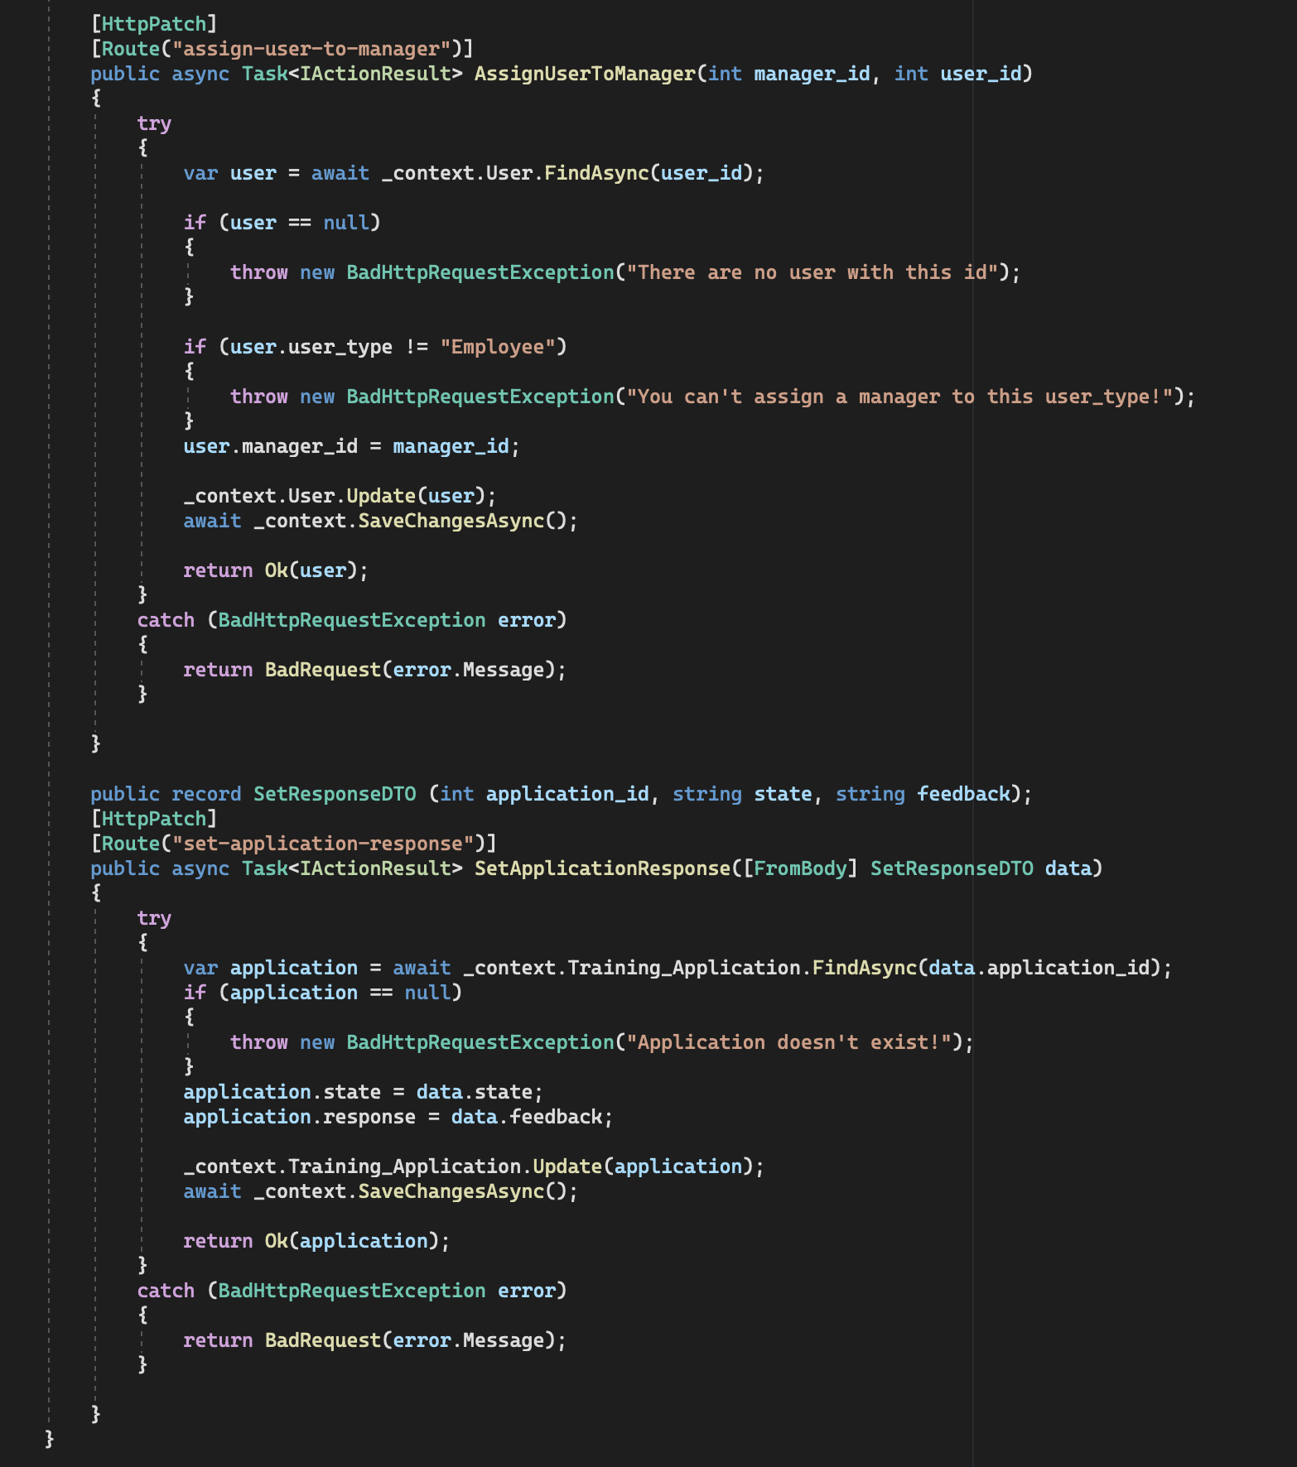
Important areas of the Project with screenshots

Slide 8
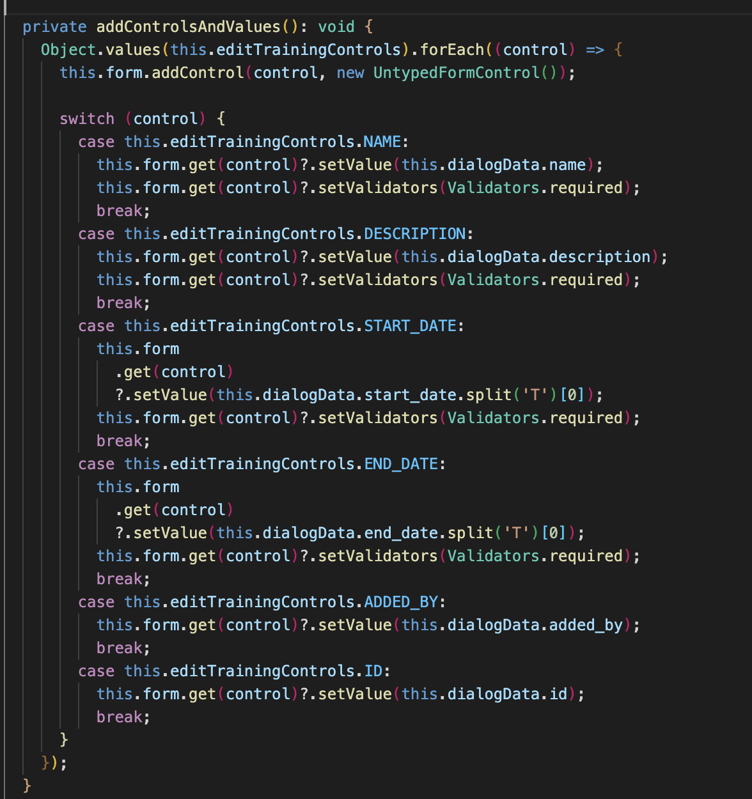
Important areas of the Project with screenshots

Slide 9
Conclusion
In conclusion, the Angular/.NET training has provided a comprehensive understanding of how to build robust web applications using two of the most powerful frameworks in web development. Through this training, I have gained practical skills in building scalable and maintainable web applications, as well as gained knowledge in integrating front-end and back-end technologies.
The training has covered key topics such as Angular components, services, directives, and routing, as well as .NET concepts such as ASP.NET Core, Entity Framework Core, and Web API. Additionally, participants have learned how to leverage the power of TypeScript, the popular superset of JavaScript, to build more robust and efficient web applications.
Overall, the Angular/.NET training has equipped participants with the skills and knowledge needed to build modern, scalable, and high-performing web applications using these two powerful frameworks. This training is highly recommended for developers looking to build complex web applications that are easy to maintain and extend.

Slide 10
Thank You
www.collaberadigital.com

